Slide 1

LJMU MSc DS/ML C28

Slide 2


Course: MSDS/ML
Live Session On: Revision Deep Learning & Computer Vision
Instructor: Dr. Jyoti Dabass

Slide 3
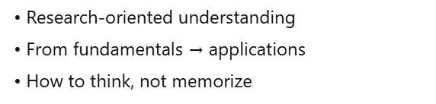
Session Direction
Notes:
Note to SMEs: Start the session with a recall of the concepts taught in core content would help build a connection between the two
For example, if teaching a session on e-skills, asking the learners what they understood from the first module or the core concepts that were taught in module

Slide 4
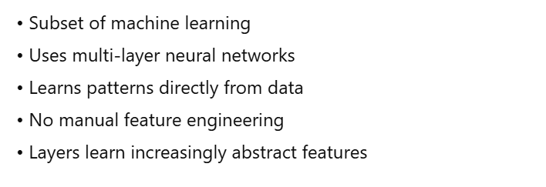
What Is Deep Learning-The Real Answer ?
Notes:
Note to SMEs: Start the session with a recall of the concepts taught in core content would help build a connection between the two
For example, if teaching a session on e-skills, asking the learners what they understood from the first module or the core concepts that were taught in module

Slide 5
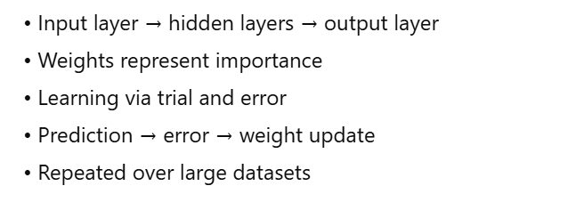
Neural Networks- The Foundation
Notes:
Note to SMEs: Start the session with a recall of the concepts taught in core content would help build a connection between the two
For example, if teaching a session on e-skills, asking the learners what they understood from the first module or the core concepts that were taught in module

Slide 6
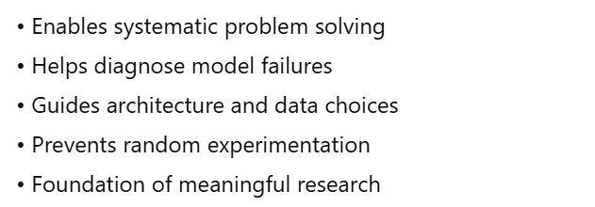
Why This Matters for Your Research

Slide 7
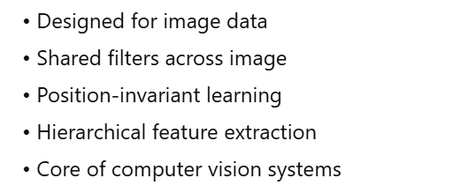
Convolutional Neural Networks – For Images

Slide 8
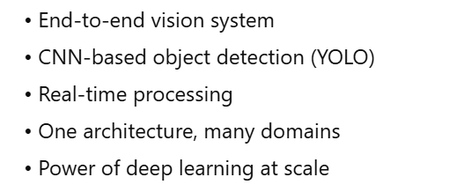
Real World Example – Putting It Together

Slide 9
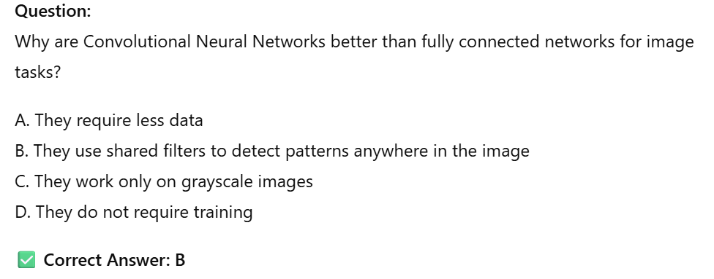
MCQ 1

Slide 10
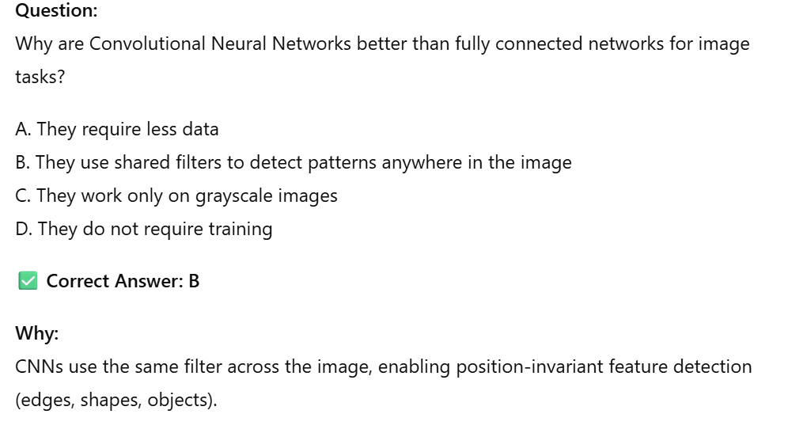
MCQ 1 (Answer)

Slide 11
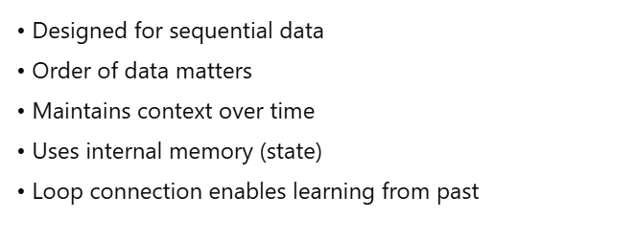
Recurrent Neural Networks – For Sequential Data

Slide 12
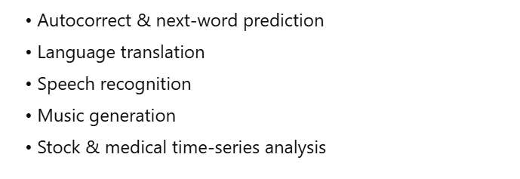
RNN Applications You Use Daily

Slide 13
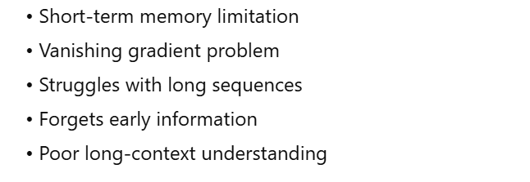
The Problem With Basic RNNs

Slide 14
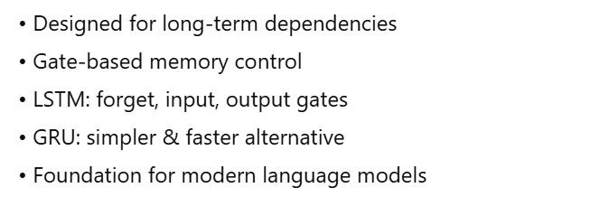
LSTM AND GRU – The Solutions

Slide 15
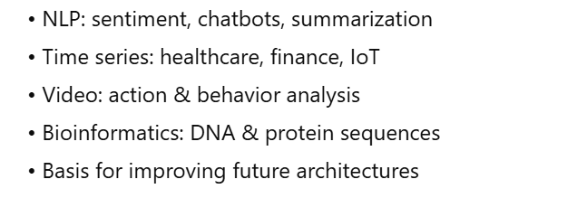
Where RNNs Fit In Your Research

Slide 16
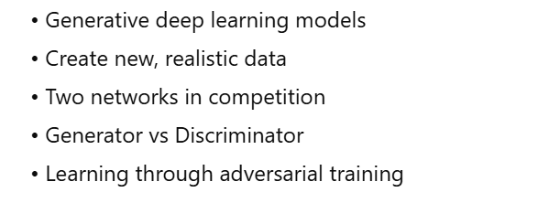
Generative Adversarial Networks (GANs)

Slide 17
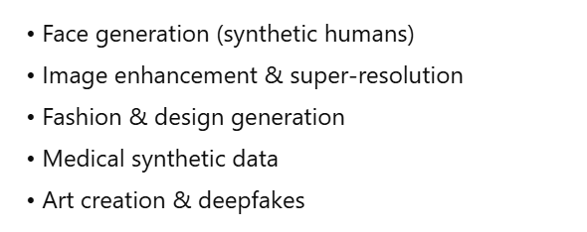
GAN Applications in the Real World

Slide 18
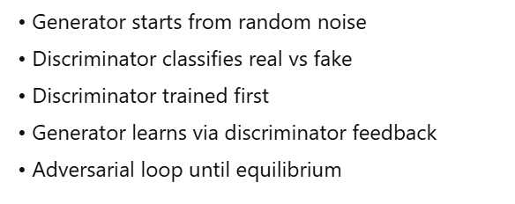
How GANs Actually Work – Technical Details

Slide 19
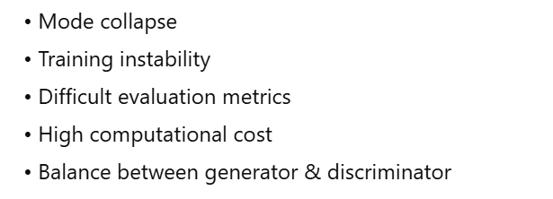
Challenges with GANs

Slide 20
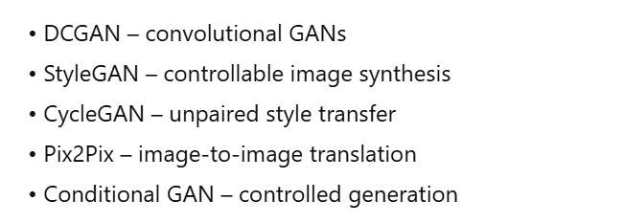
Variants of GANs You Should Know

Slide 21
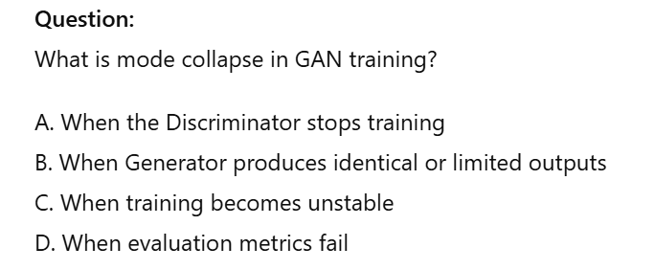
MCQ 2

Slide 22
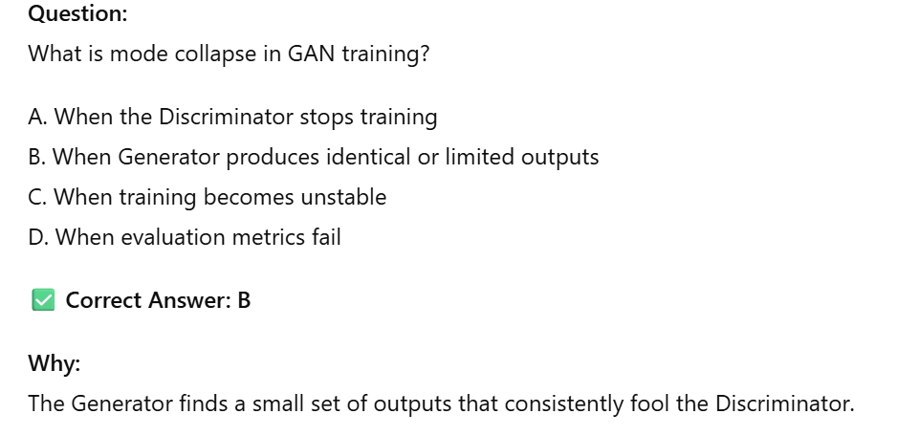
MCQ 2 (Answer)

Slide 23
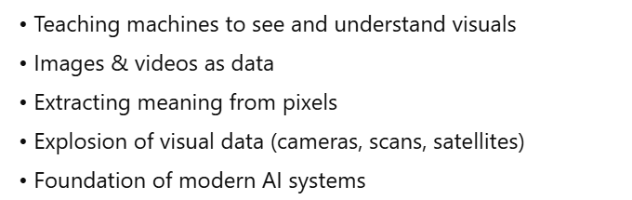
Introduction to Computer Vision

Slide 24
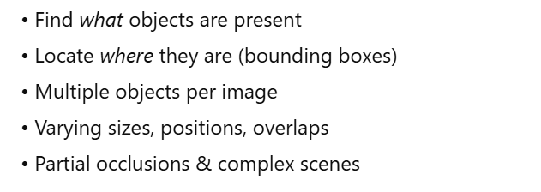
Object Detection – The Core Problem

Slide 25
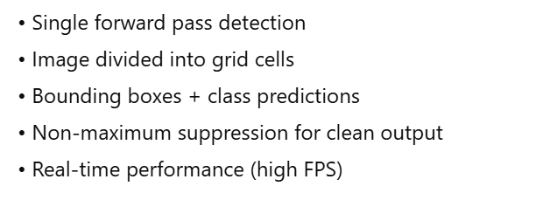
YOLO – You Only Look Once

Slide 26
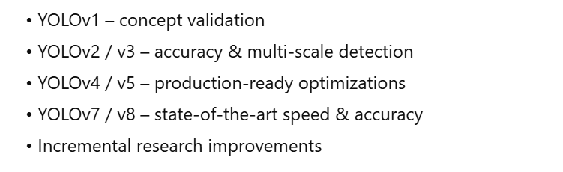
YOLO Versions and Improvements

Slide 27
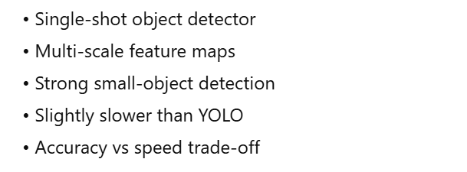
SSD – Single Shot MultiBox Detector

Slide 28
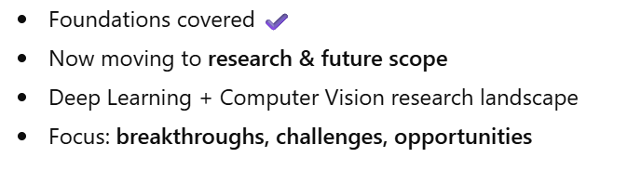
Transition To Research Discussion

Slide 29
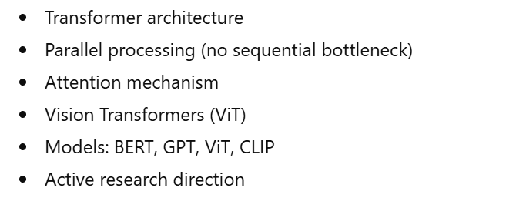
Transformers - The Current Revolution

Slide 30
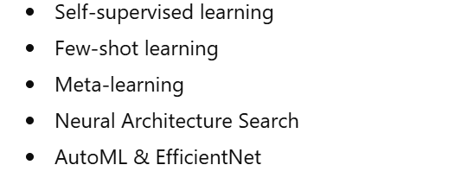
Breakthrough Research In Computer Vision

Slide 31
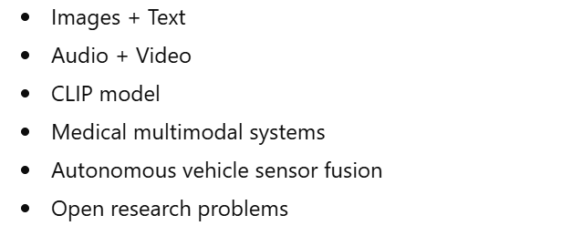
Multimodal Learning - Combining Different Data Types

Slide 32
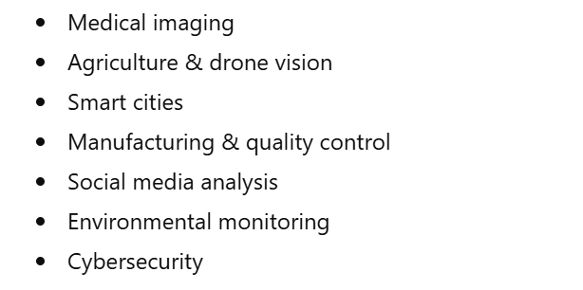
Practical Research Areas For Your Thesis

Slide 33
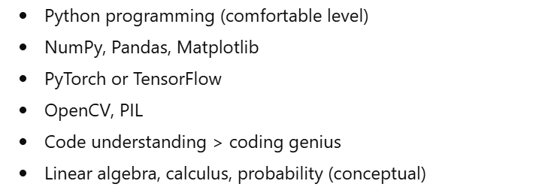
Prerequisites For Research

Slide 34
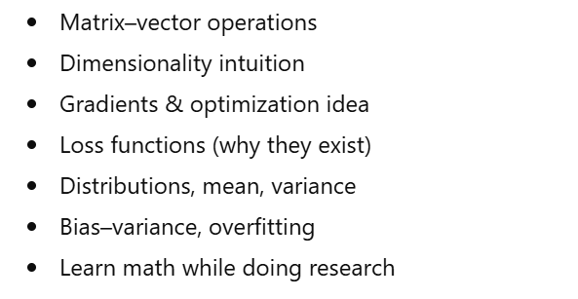
What Mathematics You Really Need

Slide 35
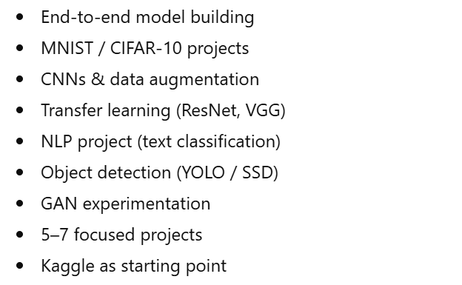
Hands-on Practice Requirements

Slide 36
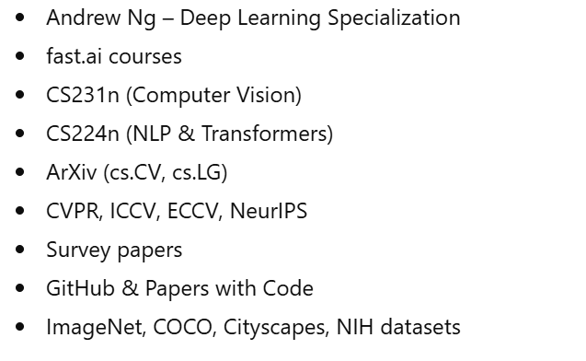
Resources For Learning And Research

Slide 37
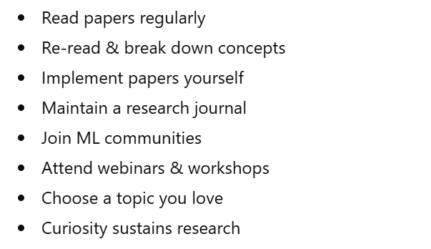
Building Your Research Skills

Slide 38
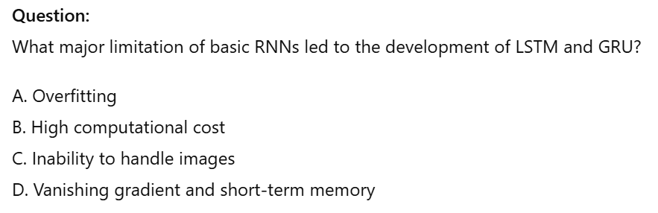
MCQ 3

Slide 39
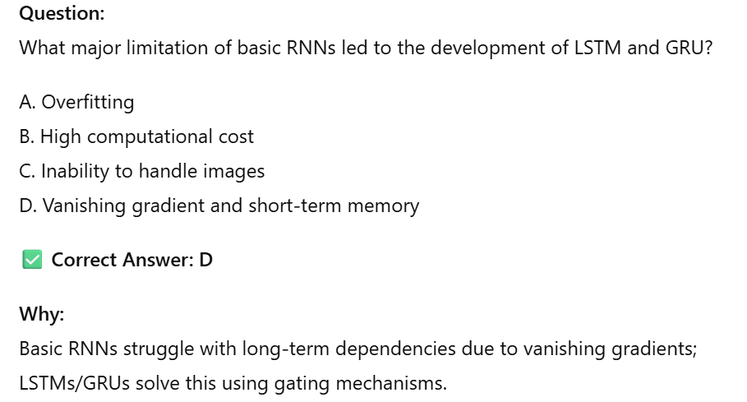
MCQ 3 (Answer)

Slide 40
PART II: LIVE CODING Link

Slide 41
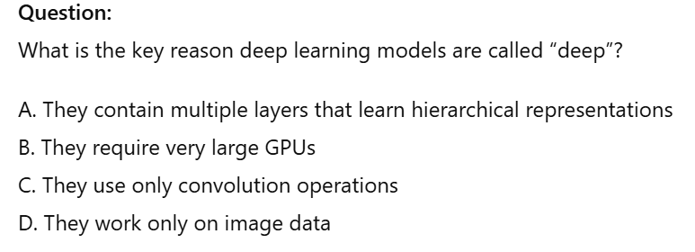
MCQ 4

Slide 42
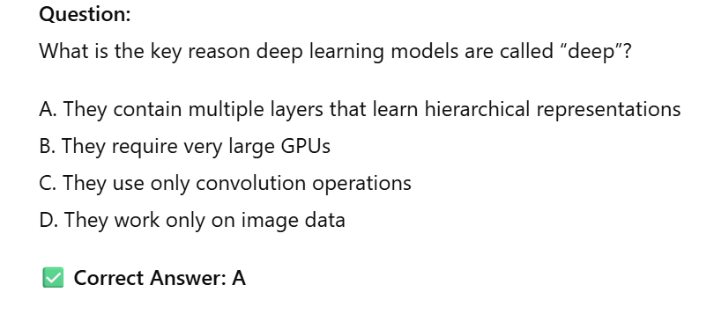
MCQ 4 (Answer)

Slide 43
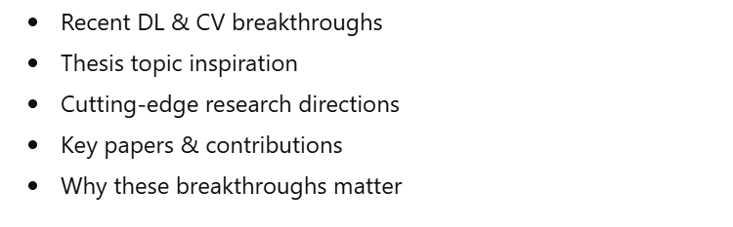
Part III - Cutting-edge Research And Breakthroughs

Slide 44
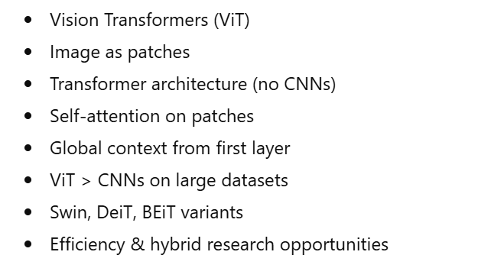
Breakthrough 1 - Vision Transformers Revolutionizing Computer Vision

Slide 45
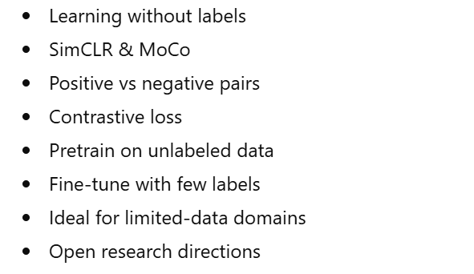
Breakthrough 2 - Self-supervised Learning With Contrastive Methods

Slide 46
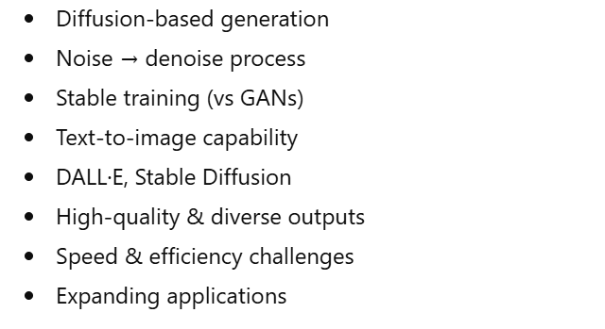
Breakthrough 3 - Diffusion Models For Image Generation

Slide 47
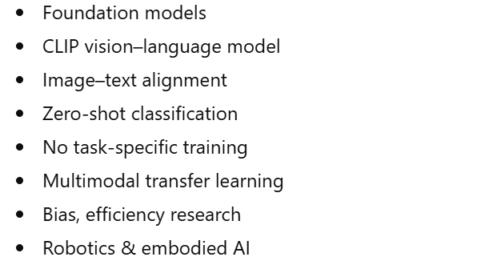
Breakthrough 4 - Foundation Models And Zero-shot Learning

Slide 48
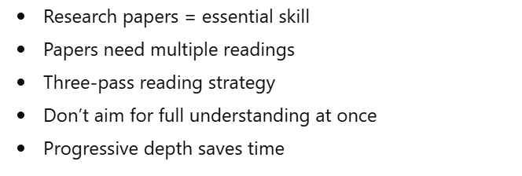
How To Read Research Papers Effectively

Slide 49
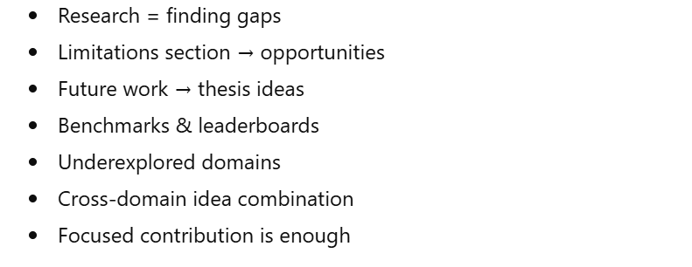
Identifying Research Gaps And Opportunities

Slide 50
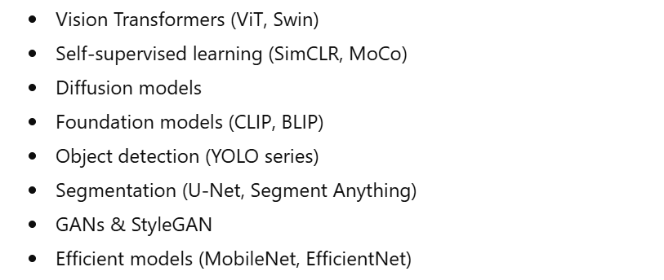
Recent Research Papers You Should Read

Slide 51
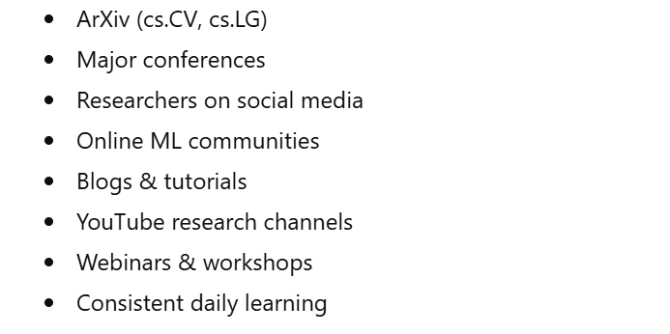
Staying Updated With Research

Slide 52
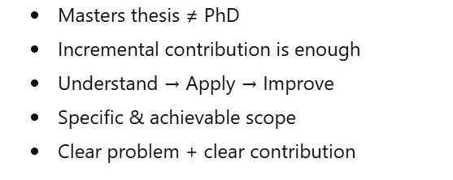
Understanding Research Thesis Scope

Slide 53
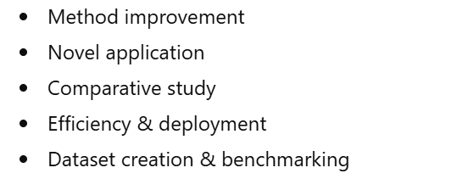
Research Categories For Your Thesis

Slide 54

Specific Thesis Ideas – Deep Learning Focus

Slide 55

Specific Thesis Ideas – Computer Vision Focus

Slide 56

Multimodal And Application-oriented Ideas

Slide 57

Choosing Your Research Direction

Slide 58

Practical Research Process & Tools

Slide 59

The Research Workflow – Seven Steps

Slide 60

Step One – Literature Review

Slide 61

Step Two – Problem Formulation

Slide 62

Step Three – Dataset Selection Or Creation

Slide 63

Step Four – Experimental Setup

Slide 64

Step Five – Baseline Implementation

Slide 65

Step Six – Iterative Experimentation

Slide 66

Step Seven – Analysis And Documentation

Slide 67

Tools And Resources You Need

Slide 68

Time Management For Research

Slide 69

MCQ 5

Slide 70

MCQ 5 (Answer)

Slide 71

Part IV: Prerequisites & Resources

Slide 72

Prerequisites & Resources

Slide 73

Essential Prerequisites – Technical Skills

Slide 74

Category One: Programming Skills

Slide 75

Category Two: Mathematics Fundamentals

Slide 76

Category Three: Machine Learning Fundamentals

Slide 77

Category Four: Deep Learning Foundations

Slide 78

Modern Prerequisites – 2025-26 Additions

Slide 79

Soft Skills And Research Skills

Slide 80

Who Can Do Research In This Domain?

Slide 81

Part V: Final Q & A and Wrap-up

Slide 82

Final Q&A Session

Slide 83

Common Questions – Anticipating Your Concerns

Slide 84

Question One: "How do I choose between deep learning and computer vision for my thesis?"

Slide 85

Question Two: "I don't have access to powerful GPUs. Can I still do meaningful research?"

Slide 86

Question Three: "What if I start my thesis and realize my idea doesn't work?"

Slide 87

MCQ 6

Slide 88

MCQ 6(Answer)

Slide 89

Question Four: "Should I focus on publishing a paper or just completing my thesis?"

Slide 90

Question Five: "How important is the specific topic I choose? What if I choose the wrong thing?"

Slide 91

Wrapping Up The Q&A

Slide 92

Part V: Final Wrap-up And Closing

Slide 93

Continuing Q&A – Taking Live Questions From Audience

Slide 94

Question: "Is it better to focus on one deep learning framework or learn multiple?"

Slide 95

PyTorch vs TensorFlow – Practical Advice

Slide 96

Key Advice on Framework Learning

Slide 97

Example Question: "How important is mathematics? Can I do research if my math is weak?"

Slide 98

Essential Math for Deep Learning Research

Slide 99

How to Improve Math Effectively

Slide 100

Example Question: "What about ethical considerations in computer vision research?"

Slide 101

Ethical Concerns in Computer Vision

Slide 102

Environmental Impact of Deep Learning

Slide 103

Ethics in Your Thesis

Slide 104

Example Question: "Any final tips for someone starting their thesis journey?"

Slide 105

Top Final Tips – Part 1

Slide 106

Top Final Tips – Part 2

Slide 107

Top Final Tips – Part 3

Slide 108

Final Summary And Key Takeaways

Slide 109

MCQ 7

Slide 110

MCQ 7 (Answer)

Slide 111

Part One: Deep Learning Fundamentals

Slide 112

Part Two: Computer Vision

Slide 113

Part Three: Research Landscape

Slide 114

Part Four: Prerequisites and Resources

Slide 115

The Path Forward

Slide 116

What To Do Next – Action Plan

Slide 117

Research Is a Journey

Slide 118
Deep Learning & Computer Vision
Complete Demo Links & Resources
8 Hands-On Demonstrations with Kaggle, GitHub & Hugging Face Links

Slide 119
What You'll Find Here
1
MNIST Neural Network
Basic feedforward networks
CNN for MNIST
🎯 Quick Start Tips
2
Convolutional neural networks
• All Kaggle notebooks have free GPU access
• Click 'Copy and Edit' to fork and run
• Start with MNIST for beginners
• Hugging Face models are ready to use
3
Transfer Learning with ResNet
Pre-trained models
4
YOLOv8 Object Detection
Real-time object detection
5
Custom YOLO Training
Train on custom datasets
6
Custom Image Classification
Fine-tune classifiers
7
U-Net Semantic Segmentation
Pixel-level classification
8
Super Resolution
Image enhancement

Slide 120
Demonstration 1: MNIST Neural Network
📚 What You'll Learn
💡 Key Features
• Basic feedforward neural networks
• Training loops and backpropagation
• PyTorch fundamentals
• Model evaluation metrics
✓ Well-documented code
✓ Beginner-friendly
✓ GPU enabled by default
✓ Visualization included
✓ ~95%+ accuracy
🔗 Top Kaggle Notebooks
kaggle.com/code/cgurkan/
mnist-with-pytorch-cnn
kaggle.com/code/amsharma7/
mnist-pytorch-for-beginners-detailed-desc
Difficulty Level: ⭐ Beginner

Slide 121
Demonstration 2: CNN for MNIST
📚 What You'll Learn
💡 Key Features
• Convolutional neural networks
• Conv layers, pooling, batch norm
• Feature extraction
• Advanced architectures
✓ CNN architecture explained
✓ Better accuracy than NN
✓ Visualization of filters
✓ Data augmentation
✓ ~99%+ accuracy achievable
🔗 Top Kaggle Notebooks
kaggle.com/code/sdelecourt/
cnn-with-pytorch-for-mnist
kaggle.com/code/abhinand05/
mnist-introduction-to-computervision-with-pytorch
Difficulty Level: ⭐⭐ Intermediate

Slide 122
Demonstration 3: Transfer Learning with ResNet
📚 What You'll Learn
💡 Key Benefits
• Using pre-trained models (ResNet18, ResNet50)
• Fine-tuning strategies and layer freezing
• Custom dataset preparation
• Train with less data
• Faster convergence
• State-of-the-art accuracy
🔗 Top Kaggle Notebooks
• kaggle.com/code/samuelcortinhas/transfer-learning-with-pytorch-resnet50
• kaggle.com/code/pmigdal/transfer-learning-with-resnet-50-in-pytorch
• kaggle.com/code/manzoormahmood/transfer-learning-using-resnet50-and-pytorch
• kaggle.com/code/kaustubhshirpurkar/transfer-learning-resnet18-pytorch
Difficulty Level: ⭐⭐ Intermediate

Slide 123
Demonstration 4: YOLOv8 Object Detection
📚 What You'll Learn
🎯 Use Cases
• Real-time object detection
• YOLOv8 architecture
• Inference on images/videos
• Bounding box predictions
✓ Vehicle detection
✓ People counting
✓ Safety monitoring
✓ Product detection
🔗 Resources
✓ Wildlife tracking
Kaggle Notebooks:
• kaggle.com/code/melissamonfared/object-detection-yolov8
• kaggle.com/code/bibo600/object-detection-using-yolov8
GitHub:
• github.com/mohamedamine99/YOLOv8-custom-object-detection
⚡ Fast & Accurate
Difficulty: ⭐⭐ Intermediate

Slide 124
Demonstration 5: Custom YOLO Training
📚 What You'll Learn
• Prepare custom datasets for YOLO
• Annotation formats and tools
• Training YOLOv8 from scratch or fine-tuning
• Hyperparameter tuning and optimization
🔗 Top Kaggle Notebooks
• kaggle.com/code/thesnak/06-train-yolov8-object-detection-on-custom-datase
• kaggle.com/code/elahehgolrokh/training-object-detection-model-using-yolo8
💡 Pro Tips for Success
• Start with 100-500 annotated images per class
• Use data augmentation to increase dataset size
• Monitor mAP (mean Average Precision) during training
Difficulty Level: ⭐⭐⭐ Advanced

Slide 125
Demonstration 6: Custom Image Classification
📚 Build Your Own Classifier
🎯 Applications
This demonstration shows you how to train image classifiers on your own datasets using transfer learning from Demonstration 3.
Key Steps:
1. Organize images into class folders
2. Load pre-trained ResNet/EfficientNet
3. Replace final layer for your classes
4. Fine-tune on your dataset
• Medical imaging
• Product quality control
• Plant disease detection
• Document classification
• Wildlife species ID
🔗 Use Transfer Learning notebooks from Demo 3
Difficulty: ⭐⭐ Intermediate

Slide 126
Demonstration 7: U-Net Semantic Segmentation
📚 Pixel-Level Classification
U-Net is the gold standard for semantic segmentation. Learn to classify every pixel in an image into categories like buildings, roads, vegetation, etc.
🔗 Top Resources
💡 Use Cases
Kaggle Notebooks:
• kaggle.com/code/gokifujiya/aerial-semantic-segmentation-u-net-pytorch
• kaggle.com/code/balraj98/unet-for-building-segmentation-pytorch
• kaggle.com/code/gokulkarthik/image-segmentation-with-unet-pytorch
GitHub (Production-Ready):
• github.com/milesial/Pytorch-UNet
Tutorial:
• medium.com/@fernandopalominocobo/mastering-u-net-...
• Medical image segmentation (tumors, organs)
• Satellite image analysis (buildings, roads)
• Autonomous driving (lane detection, obstacles)
• Agricultural monitoring (crop health)
⭐ Recommended: Start with the GitHub repository by milesial - it's the most popular and well-maintained PyTorch U-Net implementation!
Difficulty Level: ⭐⭐⭐ Advanced

Slide 127
Demonstration 8: Super Resolution
📚 Enhance Image Resolution
⚡ Quick Start
Use deep learning to upscale images and recover fine details. Transform low-resolution images into high-quality outputs.
Hugging Face models are the easiest way to get started - just load and use!
🔗 Resources
💡 Applications
Kaggle (SRGAN):
• kaggle.com/code/balraj98/single-image-super-resolution-gan-srgan-pytorch
Hugging Face (Ready-to-Use):
• huggingface.co/eugenesiow/rcan-bam
• huggingface.co/eugenesiow/han
GitHub:
• github.com/sgrvinod/a-PyTorch-Tutorial-to-Super-Resolution
• github.com/eugenesiow/super-image
• Photo restoration
• Medical imaging
• Satellite imagery
• Video upscaling
• Print enlargement
Difficulty: ⭐⭐ Intermediate

Slide 128
🚀 Getting Started
📊 Kaggle
💻 GitHub
🤗 Hugging Face
✓ Free GPU access
✓ Production-ready code
✓ Pre-trained models
✓ Pre-installed libraries
✓ Well-documented
✓ One-line loading
✓ Click 'Copy & Edit' to run
✓ Active maintenance
✓ State-of-the-art results
✓ Community discussions
✓ Clone and customize
✓ No training needed
Best for beginners
Best for projects
Easiest to use
💡 Pro Tip: Start with Kaggle notebooks for hands-on learning, then explore GitHub repos for production code!

Slide 129
Ready to Build? 🚀
✓ All resources are free and ready to use
✓ Start with MNIST, progress to advanced topics
✓ GPU access available on Kaggle
✓ Join communities for help and discussions
Happy Learning! 🎓

Slide 130

Final Message

Slide 131
Thank You!

